Slide 1

NLP and Word Embeddings
Word representation
deeplearning.ai

Slide 2
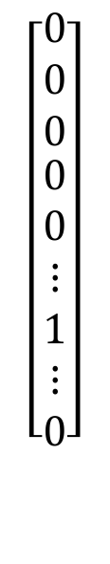
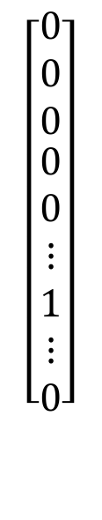
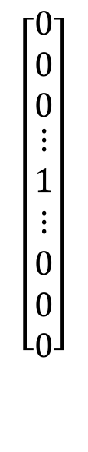
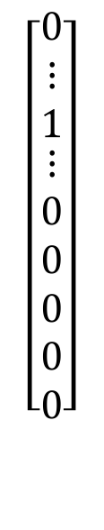
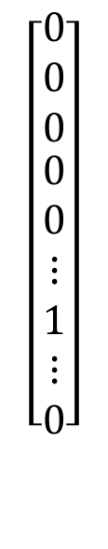
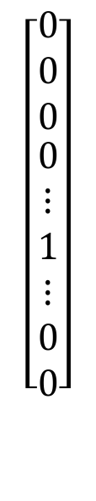
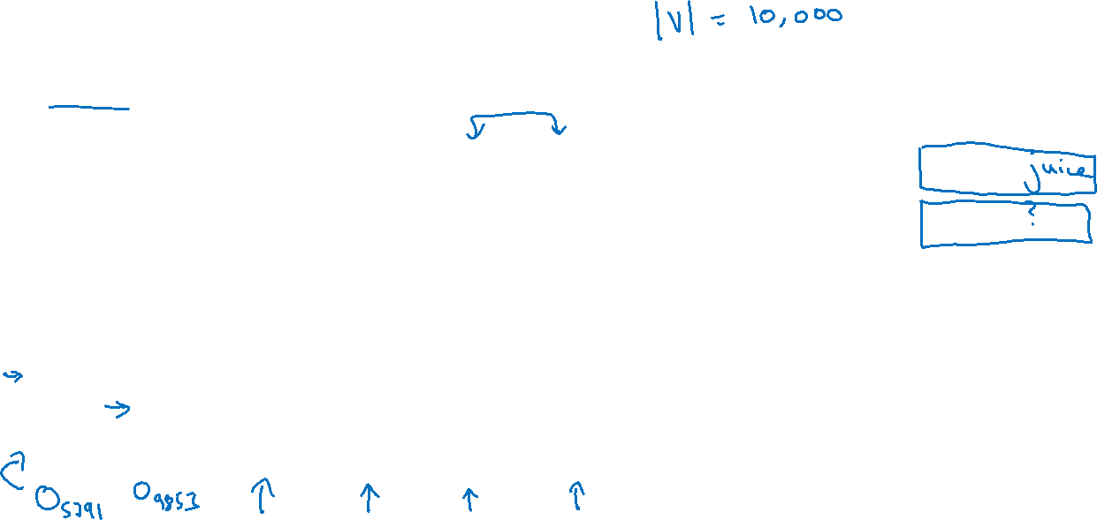
Word representation
V = [a, aaron, …, zulu, <UNK>]
1-hot representation
Man
(5391)
Woman
(9853)
King
(4914)
Queen
(7157)
Apple
(456)
Orange
(6257)
I want a glass of orange ______.
I want a glass of apple______.
$$\left[\begin{aligned}\begin{matrix}0 \\ 0 \\ 0\end{matrix} \\ 0 \\ ⋮ \\ 1 \\ ⋮ \\ 0 \\ 0\end{aligned}\right]$$
$$\left[\begin{aligned}\begin{matrix}0 \\ 0 \\ 0\end{matrix} \\ 0 \\ 0 \\ ⋮ \\ 1 \\ ⋮ \\ 0\end{aligned}\right]$$
$$\left[\begin{aligned}\begin{matrix}0 \\ 0 \\ 0\end{matrix} \\ ⋮ \\ 1 \\ ⋮ \\ 0 \\ 0 \\ 0\end{aligned}\right]$$
$$\left[\begin{aligned}\begin{matrix}0 \\ 0 \\ 0\end{matrix} \\ 0 \\ 0 \\ ⋮ \\ 1 \\ ⋮ \\ 0\end{aligned}\right]$$
$$\left[\begin{aligned}\begin{matrix}0 \\ ⋮ \\ 1\end{matrix} \\ ⋮ \\ 0 \\ 0 \\ 0 \\ 0 \\ 0\end{aligned}\right]$$
$$\left[\begin{aligned}\begin{matrix}0 \\ 0 \\ 0\end{matrix} \\ 0 \\ 0 \\ ⋮ \\ 1 \\ ⋮ \\ 0\end{aligned}\right]$$

Slide 3
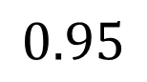
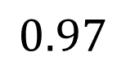
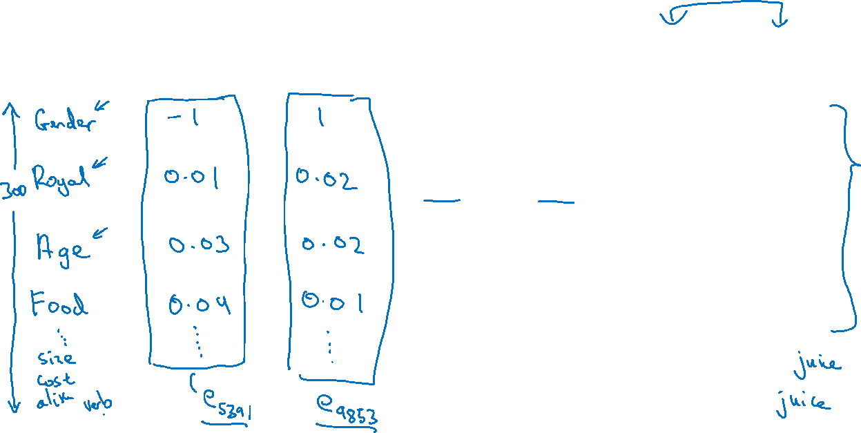
Featurized representation: word embedding
Man
(5391)
Woman
(9853)
King
(4914)
Queen
(7157)
Apple
(456)
Orange
(6257)
-0.95
$$0.97$$
0.00
0.01
0.93
$$0.95$$
-0.01
0.00
0.7
0.69
0.03
-0.02
0.02
0.01
0.95
0.97
I want a glass of orange ______.
I want a glass of apple______.

Slide 4
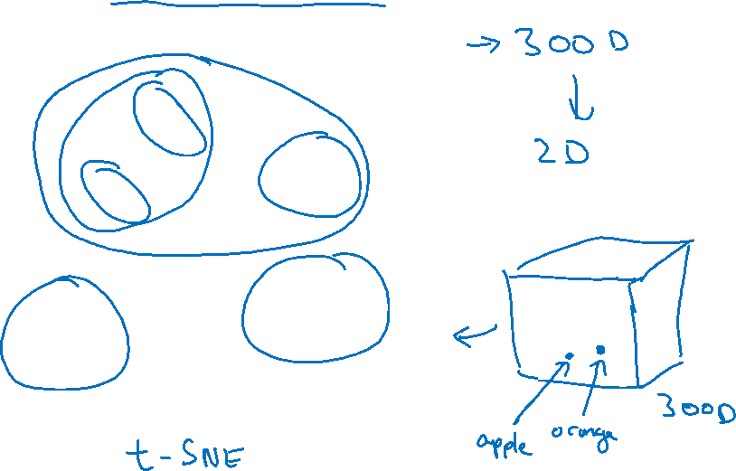
Visualizing word embeddings
man
woman
dog
king
cat
queen
fish
apple
grape
three
four
one
orange
two
[van der Maaten and Hinton., 2008. Visualizing data using t-SNE]

Slide 5
NLP and Word Embeddings
Using word embeddings
deeplearning.ai

Slide 6

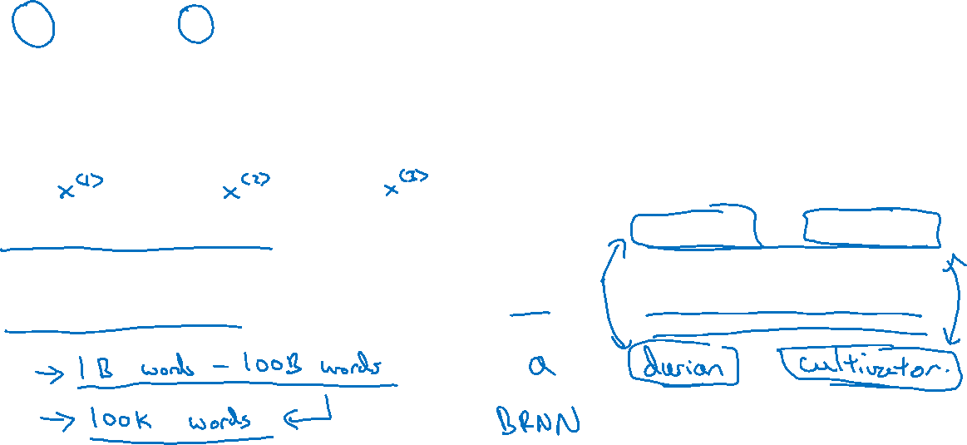

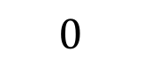
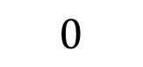
Named entity recognition example
$$1$$
$$1$$
$$0$$
$$0$$
$$0$$
$$0$$
Sally Johnson is an orange farmer
Robert Lin is an apple farmer

Slide 7
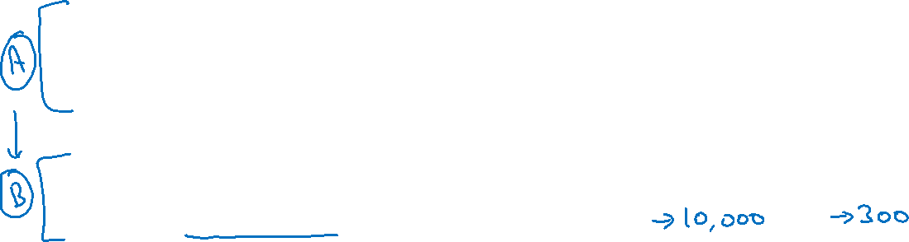
Transfer learning and word embeddings
Learn word embeddings from large text corpus. (1-100B words)
(Or download pre-trained embedding online.)
2. Transfer embedding to new task with smaller training set.
(say, 100k words)
3. Optional: Continue to finetune the word embeddings with new
data.

Slide 8
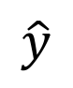
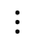
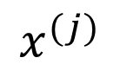
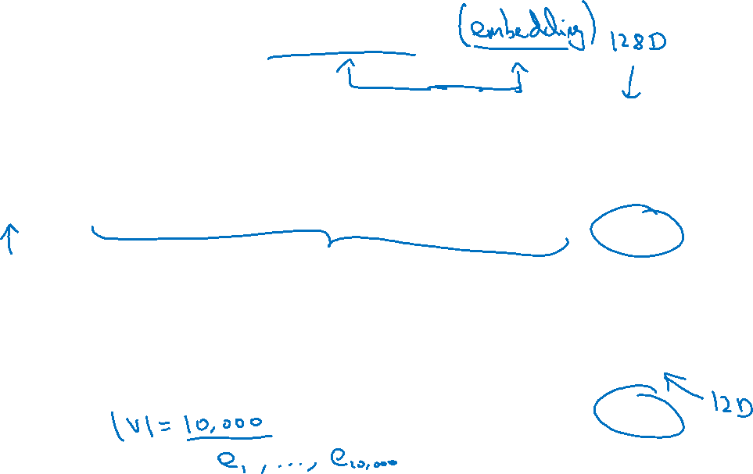
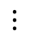
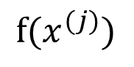
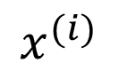
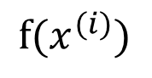
Relation to face encoding
$$⋮$$
$$x^{(i)}$$
$$f(x^{(i)})$$
$$\hat{y}$$
$$⋮$$
$$⋮$$
$$x^{(j)}$$
$$f(x^{(j)})$$
[Taigman et. al., 2014. DeepFace: Closing the gap to human level performance]

Slide 9
NLP and Word Embeddings
Properties of word embeddings
deeplearning.ai

Slide 10
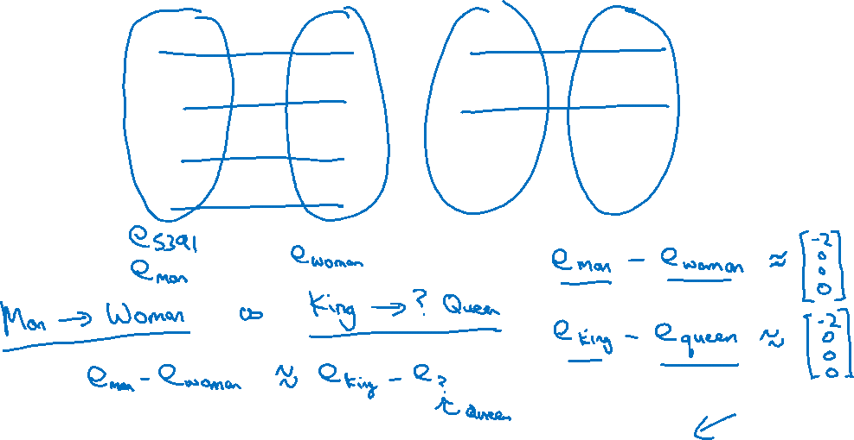
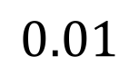
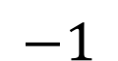
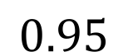
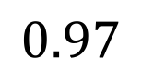
Analogies
Man
(5391)
Woman
(9853)
King
(4914)
Queen
(7157)
Apple
(456)
Orange
(6257)
Gender
$$−1$$
1
-0.95
$$0.97$$
0.00
0.01
Royal
$$0.01$$
0.02
0.93
$$0.95$$
-0.01
0.00
Age
0.03
0.02
0.70
0.69
0.03
-0.02
Food
0.09
0.01
0.02
0.01
0.95
0.97
[Mikolov et. al., 2013, Linguistic regularities in continuous space word representations]

Slide 11
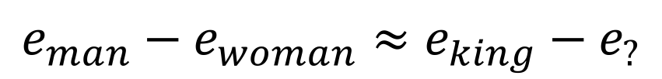
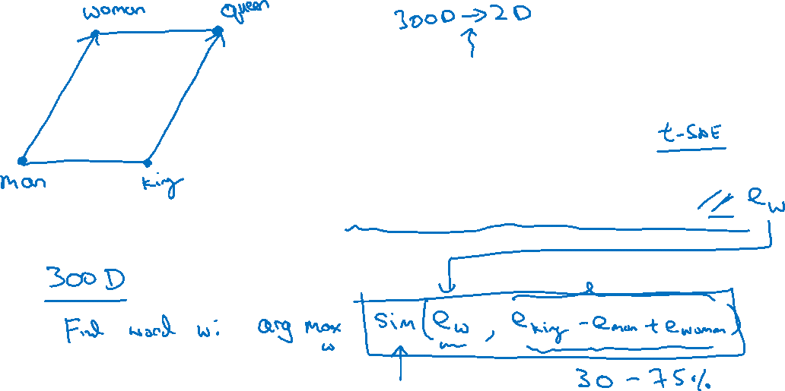
Analogies using word vectors
man
woman
dog
king
cat
queen
fish
three
four
apple
grape
one
two
orange
$$e_{man}−e_{woman}≈e_{king}−e_{?}$$

Slide 12
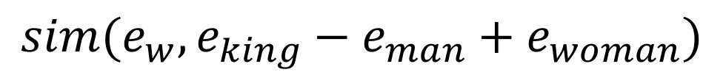
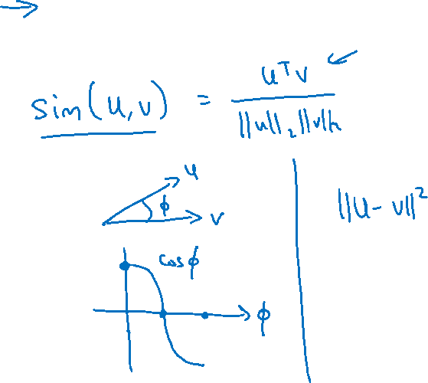
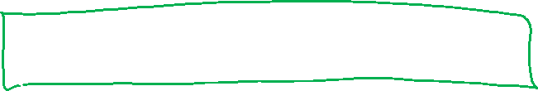
Cosine similarity
$$sim(e_{w}, e_{king}−e_{man}+e_{woman})$$
Man:Woman as Boy:Girl
Ottawa:Canada as Nairobi:Kenya
Big:Bigger as Tall:Taller
Yen:Japan as Ruble:Russia

Slide 13
NLP and Word Embeddings
Embedding matrix
deeplearning.ai

Slide 14
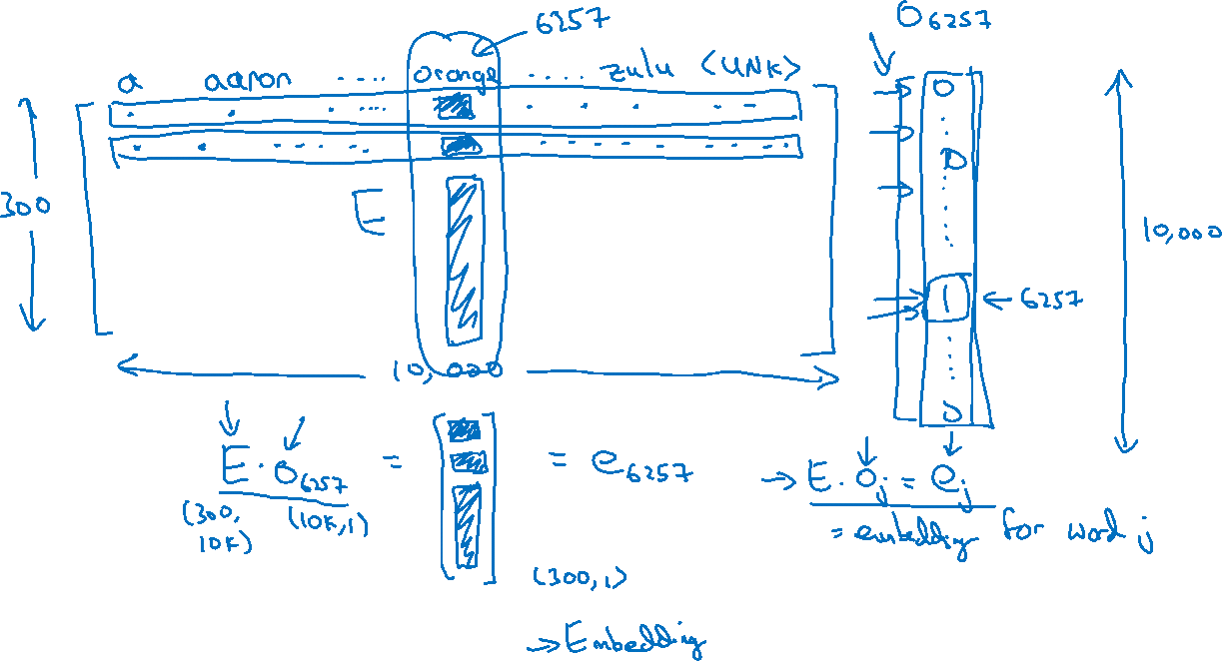
Embedding matrix
In practice, use specialized function to look up an embedding.

Slide 15
NLP and Word Embeddings
Learning word embeddings
deeplearning.ai

Slide 16
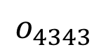
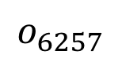
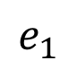
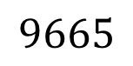
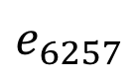
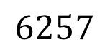
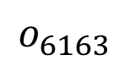
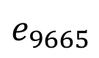
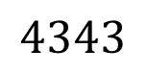
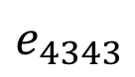
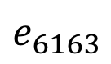
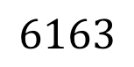
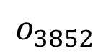
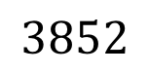
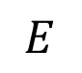
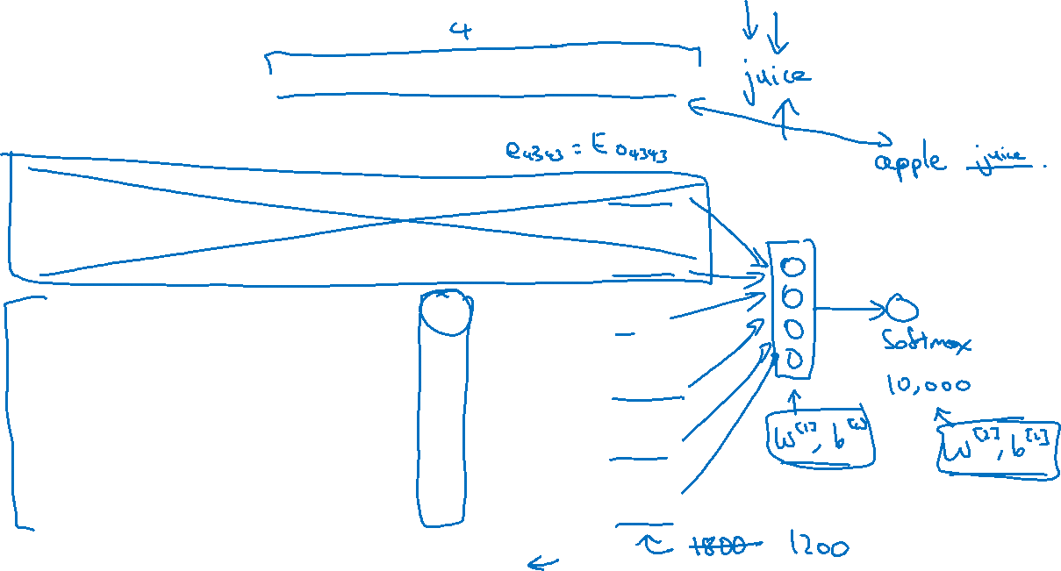





Neural language model
I want a glass of orange ______.
$$4343$$
$$9665$$
$$1$$
$$3852$$
$$6163$$
$$6257$$
I
$$o_{4343}$$
$$E$$
$$e_{4343}$$
want
$$o_{9665}$$
$$E$$
$$e_{9665}$$
a
$$o_{1}$$
$$E$$
$$e_{1}$$
glass
$$o_{3852}$$
$$E$$
$$e_{3852}$$
of
$$o_{6163}$$
$$E$$
$$e_{6163}$$
orange
$$o_{6257}$$
$$E$$
$$e_{6257}$$
[Bengio et. al., 2003, A neural probabilistic language model]

Slide 17

Other context/target pairs
I want a glass of orange juice to go along with my cereal.
Context: Last 4 words.
4 words on left & right
Last 1 word
Nearby 1 word

Slide 18
NLP and Word Embeddings
Word2Vec
deeplearning.ai

Slide 19

Skip-grams
I want a glass of orange juice to go along with my cereal.
[Mikolov et. al., 2013. Efficient estimation of word representations in vector space.]

Slide 20

Model
Vocab size = 10,000k

Slide 21




Problems with softmax classification
$$p\left(t | c\right)=\frac{e^{θ_{t}^{T}e_{c}}}{\sum_{j=1}^{10,000}{e^{θ_{j}^{T}e_{c}}}}$$
How to sample the context $c$?

Slide 22
NLP and Word Embeddings
Negative sampling
deeplearning.ai

Slide 23

Defining a new learning problem
I want a glass of orange juice to go along with my cereal.
[Mikolov et. al., 2013. Distributed representation of words and phrases and their compositionality]

Slide 24





Model
$$p\left(t | c\right)=\frac{e^{θ_{t}^{T}e_{c}}}{\sum_{j=1}^{10,000}{e^{θ_{j}^{T}e_{c}}}}$$
Softmax:
context
word
target?
orange
juice
$$1$$
orange
king
$$0$$
orange
book
$$0$$
orange
the
$$0$$
orange
of
$$0$$

Slide 25

Selecting negative examples
context
word
target?
orange
juice
$$1$$
orange
king
$$0$$
orange
book
$$0$$
orange
the
$$0$$
orange
of
$$0$$

Slide 26
NLP and Word Embeddings
GloVe word vectors
deeplearning.ai

Slide 27

GloVe (global vectors for word representation)
I want a glass of orange juice to go along with my cereal.
[Pennington et. al., 2014. GloVe: Global vectors for word representation]

Slide 28

Model

Slide 29





A note on the featurization view of word embeddings
Man
(5391)
Woman
(9853)
King
(4914)
Queen
(7157)
Gender
$$−1$$
1
-0.95
$$0.97$$
Royal
$$0.01$$
0.02
0.93
$$0.95$$
Age
0.03
0.02
0.70
0.69
Food
0.09
0.01
0.02
0.01
m$inimize \sum_{i=1}^{10,000}{\sum_{j=1}^{10,000}{f\left(X_{ij}\right){\left(θ_{i}^{T}e_{j}+b_{i}−b_{j}^{′}−\log{X_{ij}}\right)}^{2}}}$

Slide 30
NLP and Word Embeddings
Sentiment classification
deeplearning.ai

Slide 31



Sentiment classification problem
$$x$$
$$y$$
The dessert is excellent.
Service was quite slow.
Good for a quick meal, but nothing special.
Completely lacking in good taste, good service, and good ambience.

Slide 32















Simple sentiment classification model
The dessert is excellent
$$8928$$
$$2468$$
$$4694$$
$$3180$$
The
$$o_{8928}$$
$$E$$
$$e_{8928}$$
desert
$$o_{2468}$$
$$E$$
$$e_{2468}$$
is
$$o_{4694}$$
$$E$$
$$e_{4694}$$
excellent
$$o_{3180}$$
$$E$$
$$e_{3180}$$
“Completely lacking in good taste, good service, and good ambience.”

Slide 33















RNN for sentiment classification
$$\hat{y}$$
softmax
$$a^{<0>}$$
$$a^{<1>}$$
$$a^{<2>}$$
$$a^{<3>}$$
$$a^{<4>}$$
$$⋯$$
$$a^{<10>}$$
$$e_{1852}$$
$$e_{4966}$$
$$e_{4427}$$
$$e_{3882}$$
$$e_{330}$$
$$E$$
$$E$$
$$E$$
$$E$$
$$E$$
Completely lacking in good …. ambience

Slide 34
NLP and Word Embeddings
Debiasing word embeddings
deeplearning.ai

Slide 35

The problem of bias in word embeddings
Man:Woman as King:Queen
Man:Computer_Programmer as Woman:
Homemaker
Father:Doctor as Mother:
Nurse
Word embeddings can reflect gender, ethnicity, age, sexual orientation, and other biases of the text used to train the model.
[Bolukbasi et. al., 2016. Man is to computer programmer as woman is to homemaker? Debiasing word embeddings]

Slide 36

Addressing bias in word embeddings
1. Identify bias direction.
2. Neutralize: For every word that is not definitional, project to get rid of bias.
3. Equalize pairs.
[Bolukbasi et. al., 2016. Man is to computer programmer as woman is to homemaker? Debiasing word embeddings]

